Slide 1
Virtual Reality for Transfer of Learning
Rohan Shrestha
Notes:
Confused knowledge transfer (transfer of knowledge from one entity to another) with transfer of learning ( application of knowledge and information to a new situation or context)

Slide 2


Transfer of learning
Applying learned knowledge and skills in a new situation or context
Transfer of training a specific application (Wikipedia)
Notes:
Is a part of the learning process itself
We learned about transfer of training in engineering psych; transfer of training a specific application of transfer of learning
Goal of education (esp. vocational) is usually to maximize the knowledge transfer

Slide 3
Types of transfer
Positive | Prior learning helps with new learning/situation
Negative | Prior learning hinders with new learning/situation
Zero | Prior learning has no influence on new learning/situation
Near | Large overlap between prior learning and new situation
Far | New situation differs widely from the prior learning
Literal | 1:1 application of learning but in a new situation
Figural, Low road, High road, Forward reaching, Backward reaching (Schunk, 2012)
Notes:
Goal is Positive learning

Slide 4
Virtual Reality for learning
Immersive and interactive learning
Simulation of real-world scenarios
3D spatial visualization
Notes:
Learning to maximize transfer

Slide 5
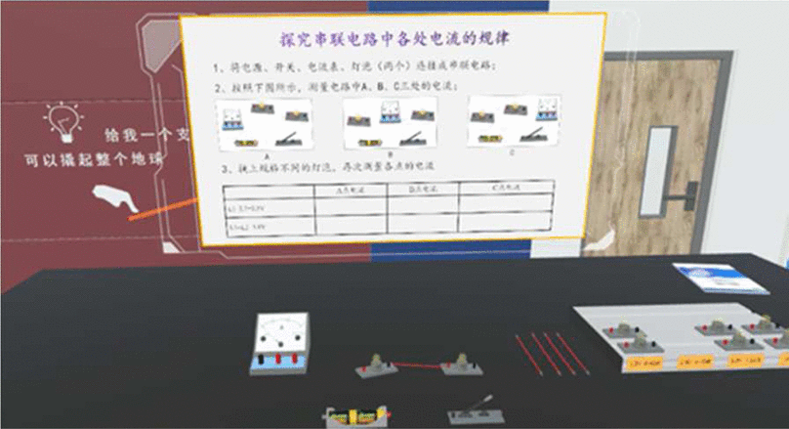
Immersive and interactive learning
Quasi-experimental research to investigate the effect of the immersive virtual reality learning environment on learners' conceptual and procedural knowledge transfer
Video group as the control group
Learning about law of current in series circuits (Gao et al., 2022)

Slide 6
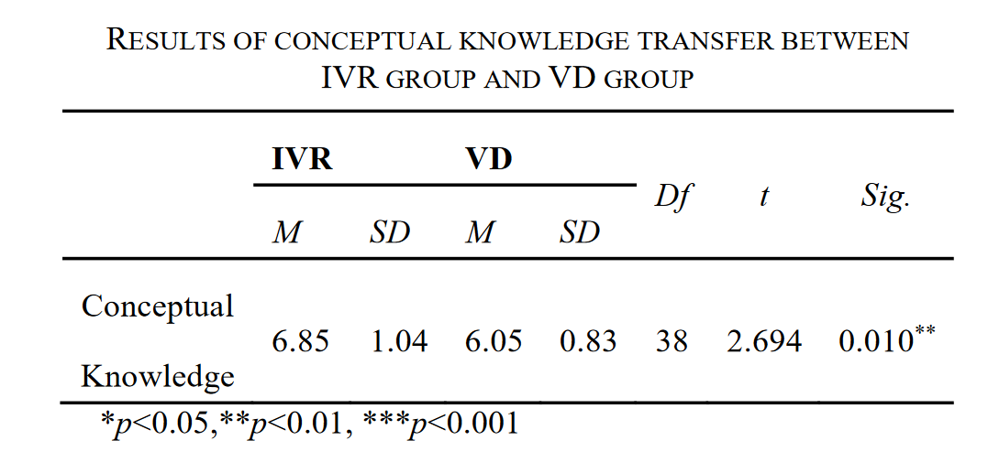
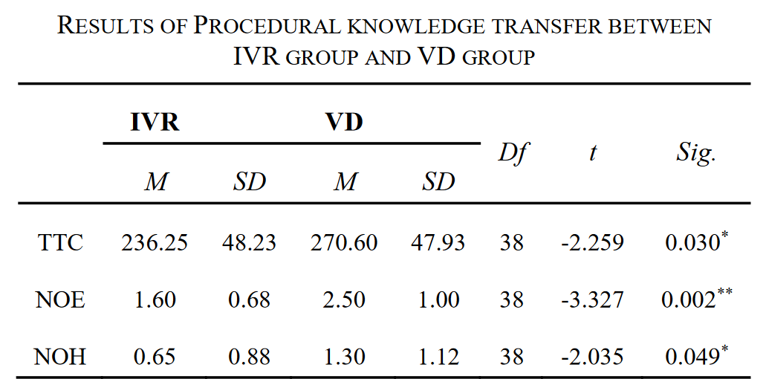
Learners in the immersive virtual reality learning environment scored significantly higher than those in the video group on both the conceptual knowledge transfer and procedural knowledge transfer tests (Gao et al., 2022).

Slide 7
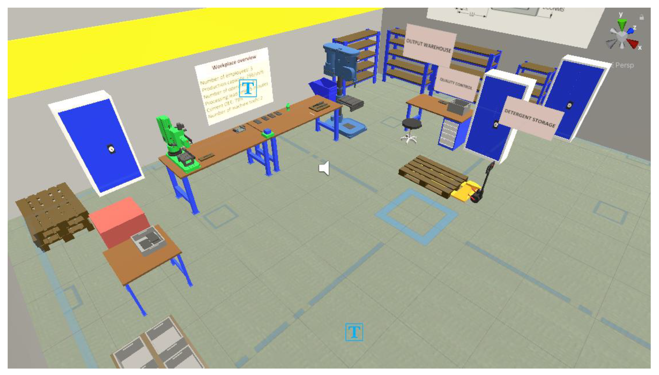
Simulation of real-world scenarios
Case study on workplace analysis and optimization with a VR replica of assigned workplace in addition to textual information
Positive self-report following the assignment on understanding of assignment goals and workplace
Workplace simulation (Krajčovič et al., 2022)

Slide 8
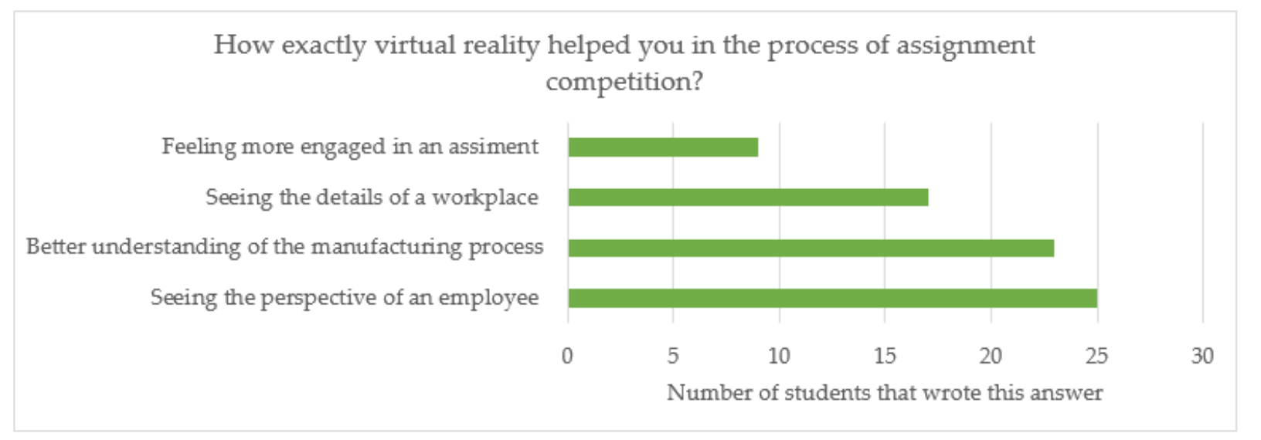
(Krajčovič et al., 2022)

Slide 9
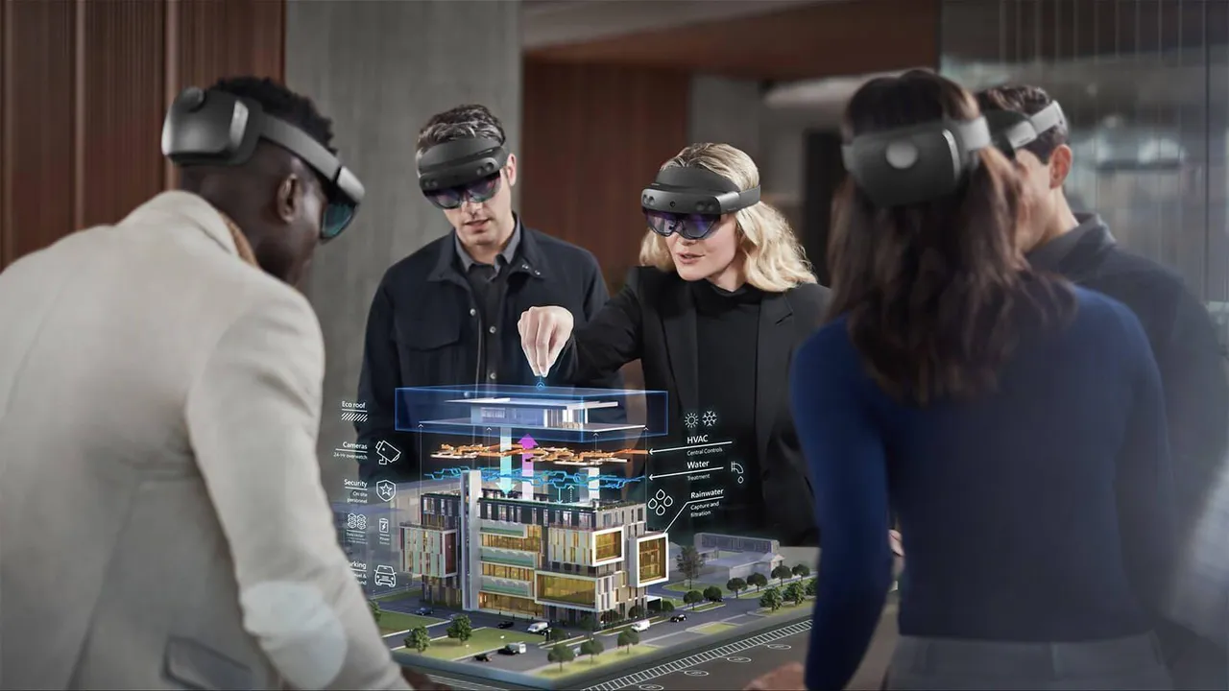
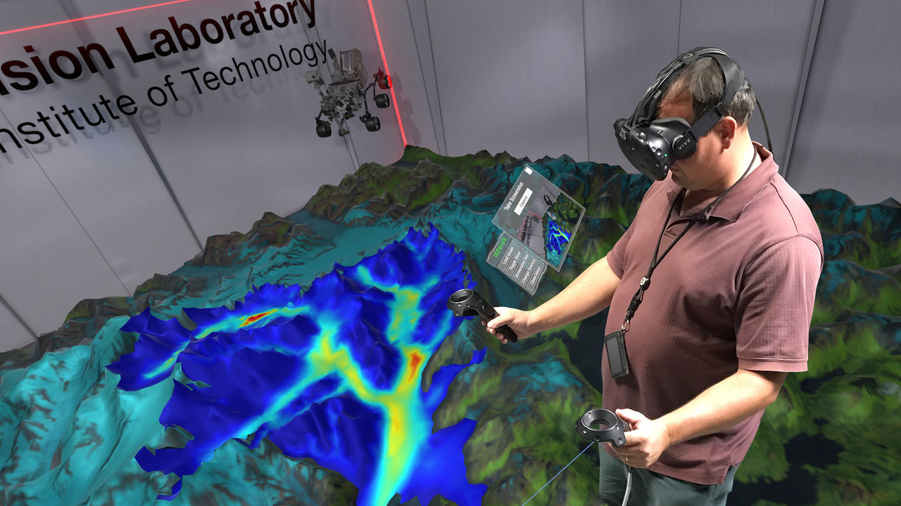
3D spatial visualization
Information visualization, scientific visualization, Collaborative exploration (Korkut & Surer, 2023)
Source: 3Data
Source: NASA
Notes:
NASA sea level; glacial imagery

Slide 10
What makes VR effective for knowledge transfer?
Similar effectiveness compared to real-world training, especially for motor skills (Kim et al., 2019; Markwell et al., 2023)
Increased student engagement (Suleman et al., 2019)
Improved attentional functioning (Lorentz et al., 2023)
Safer than real-world training for more critical jobs
Can be cheaper

Slide 11
What makes VR not so effective?
VR sickness and simulator sickness is common which negatively impacts attention and mental workload, and impairs learning (Hsin et al., 2023; Mimnaugh et al., 2023)
Mixed results on effectiveness of transfer in cognitive training (Boller et al., 2021; Gamito et al., 2017; Lorentz et al., 2023)
Current VR technology cannot accurately replicate job-specific motor movements without expensive equipments
Notes:
But VR sickness is an active area of research and development, which could mean that this problem will be obsolete with newer hardware and software

Slide 12
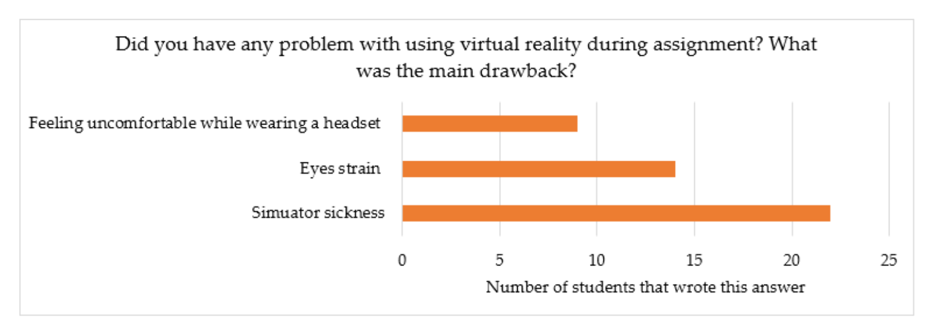
(Krajčovič et al., 2022)

Slide 13
What does the future hold?
How do you imagine VR will be used for training and education in the future?

Slide 14
References
Boller, B., Ouellet, É., & Belleville, S. (2021). Using Virtual Reality to Assess and Promote Transfer of Memory Training in Older Adults With Memory Complaints: A Randomized Controlled Trial. Frontiers in Psychology, 12, 627242. https://doi.org/10.3389/fpsyg.2021.627242
Gamito, P., Oliveira, J., Coelho, C., Morais, D., Lopes, P., Pacheco, J., Brito, R., Soares, F., Santos, N., & Barata, A. F. (2017). Cognitive training on stroke patients via virtual reality-based serious games. Disability and Rehabilitation, 39(4), 385–388. https://doi.org/10.3109/09638288.2014.934925
Gao, N., Liu, G., & Zhang, L. (2022). Investigating the Effect of Immersive VR on Conceptual Knowledge and Procedural Knowledge Transfer. 2022 Eleventh International Conference of Educational Innovation through Technology (EITT), 37–42. https://doi.org/10.1109/EITT57407.2022.00012
Hsin, L.-J., Chao, Y.-P., Chuang, H.-H., Kuo, T. B. J., Yang, C. C. H., Huang, C.-G., Kang, C.-J., Lin, W.-N., Fang, T.-J., Li, H.-Y., & Lee, L.-A. (2023). Mild simulator sickness can alter heart rate variability, mental workload, and learning outcomes in a 360° virtual reality application for medical education: A post hoc analysis of a randomized controlled trial. Virtual Reality, 27(4), 3345–3361. https://doi.org/10.1007/s10055-022-00688-6
Kim, A., Schweighofer, N., & Finley, J. M. (2019). Locomotor skill acquisition in virtual reality shows sustained transfer to the real world. Journal of NeuroEngineering and Rehabilitation, 16(1), 113. https://doi.org/10.1186/s12984-019-0584-y
Korkut, E. H., & Surer, E. (2023). Visualization in virtual reality: A systematic review. Virtual Reality, 27(2), 1447–1480. https://doi.org/10.1007/s10055-023-00753-8
Krajčovič, M., Gabajová, G., Matys, M., Furmannová, B., & Dulina, Ľ. (2022). Virtual Reality as an Immersive Teaching Aid to Enhance the Connection between Education and Practice. Sustainability, 14(15), Article 15. https://doi.org/10.3390/su14159580
Lorentz, L., Müller, K., & Suchan, B. (2023). Virtual reality-based attention training in patients with neurological damage: A pilot study. Neuropsychological Rehabilitation, 0(0), 1–20. https://doi.org/10.1080/09602011.2023.2236349
Markwell, L. T., Cochran, K., & Porter, J. M. (2023). Off the shelf: Investigating transfer of learning using commercially available virtual reality equipment. PLOS ONE, 18(10), e0279856. https://doi.org/10.1371/journal.pone.0279856
Mimnaugh, K. J., Center, E. G., Suomalainen, M., Becerra, I., Lozano, E., Murrieta-Cid, R., Ojala, T., LaValle, S. M., & Federmeier, K. D. (2023). Virtual Reality Sickness Reduces Attention During Immersive Experiences. IEEE Transactions on Visualization and Computer Graphics, 29(11), 4394–4404. https://doi.org/10.1109/TVCG.2023.3320222
Schunk, D. H. (2012). Cognitive Learning Processes. In Learning Theories: An Educational Perspective (6th ed., p. 319). Pearson/Merrill/Prentice Hall.
Suleman, M., Sugiyarto, K. H., & Ikhsan, J. (2019). Development of Media Three-dimensional (3D) Visualization using Virtual Reality on Chemistry Education. Journal of Physics: Conference Series, 1397(1), 012034. https://doi.org/10.1088/1742-6596/1397/1/012034
Transfer of learning. (2023). In Wikipedia. https://en.wikipedia.org/w/index.php?title=Transfer_of_learning&oldid=1174552809

